Slide 1

课时练习
模块五 第二章 第二节

Slide 2
一、翻译下列词组。
1. 考试不及格 _____________________________
2. 有这些感受 _____________________________
3. 在某人的那个年龄时 _____________________
4. 与某人交朋友 ___________________________
fail the exam
get/have these feelings
at one’s age
make friends with sb.

Slide 3
一、翻译下列词组。
5. 讲笑话 ____________________________
6. 使某人笑 __________________________
7. 好好休息一下 ______________________
8. 顺便提一下 ________________________
tell jokes
make sb. laugh
have a good rest
by the way

Slide 4
二、根据语境、音标或所给单词的提示完成句子， 每空一词。
1. In the final exams, I passed Chinese but _______ math.
2. It is a good idea to start a speech(演讲) by telling a _______ /dʒəʊk/.
3. The doctor _________ (miss) the golden time to save the patient(病人).
failed
joke
missed

Slide 5
二、根据语境、音标或所给单词的提示完成句子， 每空一词。
4. Local anesthesia(局部麻醉) is used to make a small area of the body lose ________ (feel).
5. I couldn’t find the station, so I asked _________ /'sʌmwʌn/ if he could direct me.
feeling
someone

Slide 6
三、单项选择。
( )1. —________, where is Peter?
—He’s talking with the English teacher in the teachers’ office.
A. By the way B. In this way C. On the way
A

Slide 7
三、单项选择。
( )2. —You’ve been overworking. _______ take a week off?
—I can’t. I have too much work to do.
A. Would you like B. Why don’t you
C. What about
B

Slide 8
三、单项选择。
( )3. —Don’t worry. I will help you ______ your math.
—Thank you. It’s very kind ______ you.
A. with; for B. with; of C. for; of
B

Slide 9
三、单项选择。
( )4. Some students join the army ________ graduating(毕业) from high school.
A. after B. before C. if
A

Slide 10
三、单项选择。
( )5. Michael _______ the history exam because he was not careful enough.
A. passed B. finished C. failed
C

Slide 11
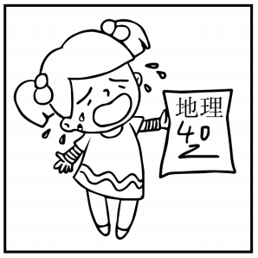
四、看图写话。
1. feel, because
The girl/She feels sad because she failed the geography exam.

Slide 12
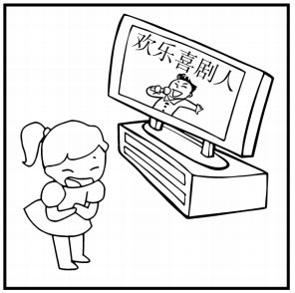
四、看图写话。
2. make
The actor/TV show makes the girl/her laugh.

Slide 13
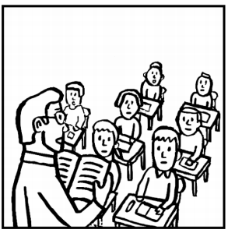
四、看图写话。
3. strict
The teacher is strict with his students.

Slide 14
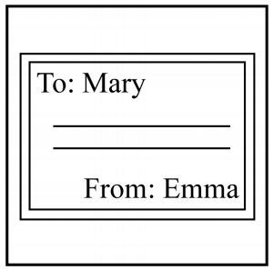
四、看图写话。
4. send, yesterday
Emma sent a card to Mary yesterday.

Slide 15
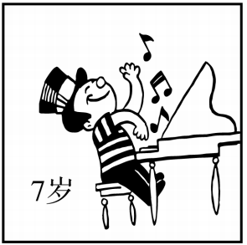
四、看图写话。
5. at, age
The boy/He could play the piano at the age of seven.

Slide 16
